Slide 1
EP82 Create Firebase Project and Connect Firebase from Flutter (1) Authen (2) FireStore DB (3) Firestorage (keep image) Case Study “Restaurant E-menu” ระบบสั่งอาหารผ่านมือถือ
See-Flutter เรียนรู้ไปด้วยกัน เรียนฟรี พร้อม Source Code
30 Sep 2020
Day#72

Slide 2
CONTENT
What is Firebase ?
Recap EP34
Create Firebase Project
Link Firebase and Flutter

Slide 3
(1)-1 What is Firebase ?
Firebase is a platform developed by Google for creating mobile and web applications. It was originally an independent company founded in 2011. In 2014, Google acquired the platform and it is now their flagship offering for app development. Wikipedia
Firebase คือ Platform ที่รวบรวมเครื่องมือต่าง ๆ สำหรับการจัดการในส่วนของ Backend หรือ Server side ซึ่งทำให้สามารถ Build Mobile Application ได้อย่างมีประสิทธิภาพ และยังลดเวลาและค่าใช้จ่ายของการทำ Server side หรือการวิเคราะห์ข้อมูลให้อีกด้วย โดยมีทั้งเครื่องมือที่ฟรี และเครื่องมีที่มีค่าใช้จ่าย (สำหรับการ Scale)
(2018, https://medium.com/jed-ng/firebase-%E0%B8%84%E0%B8%B7%E0%B8%AD%E0%B8%AD%E0%B8%B0%E0%B9%84%E0%B8%A3-%E0%B8%A1%E0%B8%B2%E0%B8%94%E0%B8%B9%E0%B8%A7%E0%B8%B4%E0%B8%98%E0%B8%B5%E0%B8%AA%E0%B8%A3%E0%B9%89%E0%B8%B2%E0%B8%87-project-%E0%B9%81%E0%B8%A5%E0%B8%B0%E0%B8%97%E0%B8%B3%E0%B8%84%E0%B8%A7%E0%B8%B2%E0%B8%A1%E0%B8%A3%E0%B8%B9%E0%B9%89%E0%B8%88%E0%B8%B1%E0%B8%81%E0%B8%81%E0%B8%B1%E0%B8%9A-firebase-d48bfac67b14#:~:text=Firebase%20%E0%B8%84%E0%B8%B7%E0%B8%AD%20Platform%20%E0%B8%97%E0%B8%B5%E0%B9%88%E0%B8%A3%E0%B8%A7%E0%B8%9A%E0%B8%A3%E0%B8%A7%E0%B8%A1,%E0%B9%83%E0%B8%8A%E0%B9%89%E0%B8%88%E0%B9%88%E0%B8%B2%E0%B8%A2%20(%E0%B8%AA%E0%B8%B3%E0%B8%AB%E0%B8%A3%E0%B8%B1%E0%B8%9A%E0%B8%81%E0%B8%B2%E0%B8%A3%20Scale,)

Slide 4
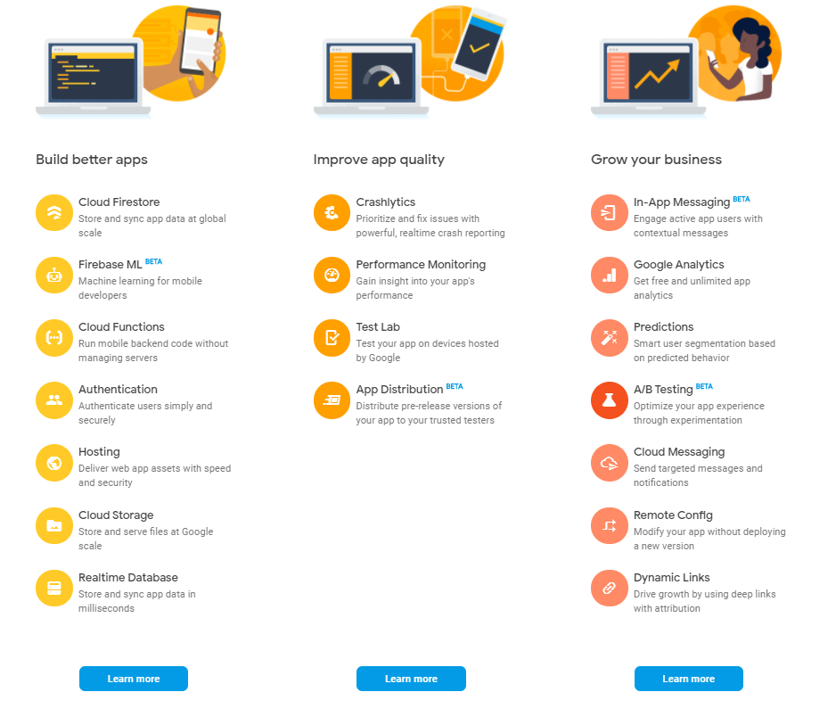
(1)-2 What is Firebase ?
CI/CD
Continuous Integration
Continueous Deployment

Slide 5
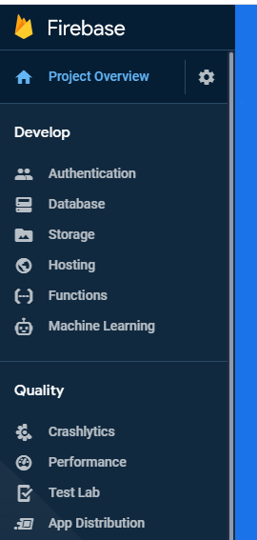
(1)-3 Google Firebase
AUTHENTICATION
(Login,signup,forget password)
E-mail, Google, SMS
Restaurant E-menu
Database
(Menu, Order)
Database
Storage
Food Image
Hosting
Website

Slide 6
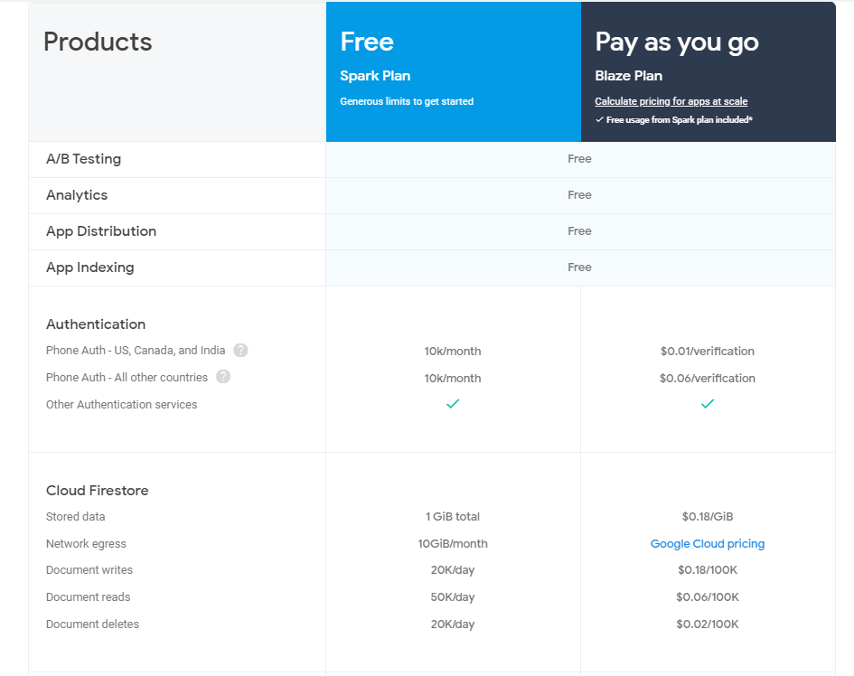
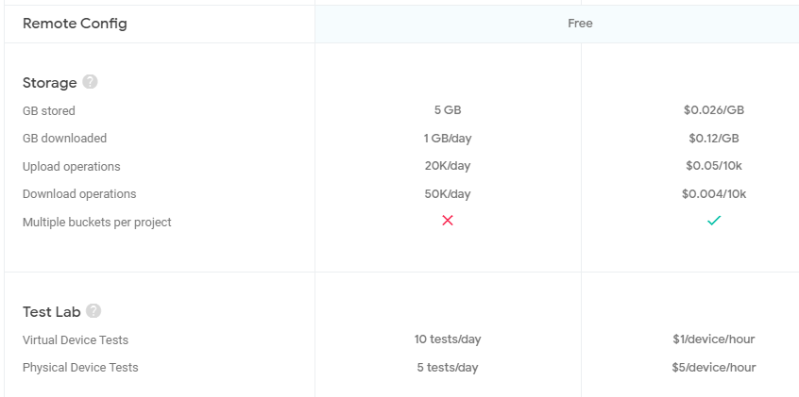
(1)-3 What is free in Firebase ?

Slide 7
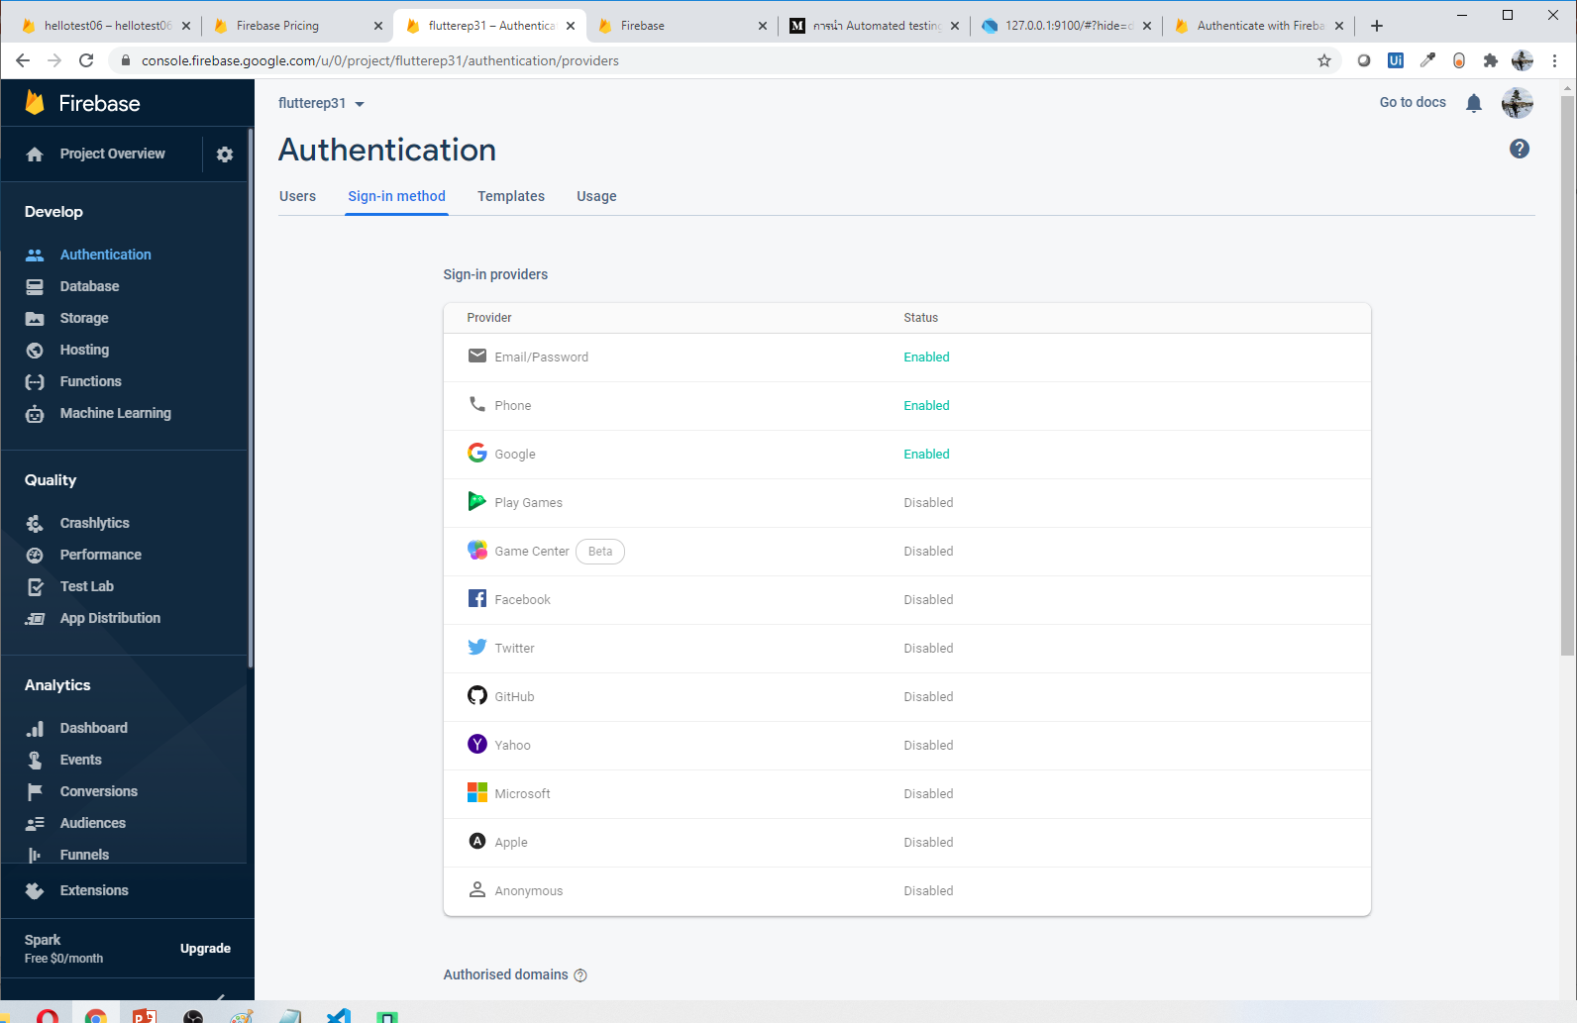
(1)-4 Start to use Firebase (Authen/Login)

Slide 8
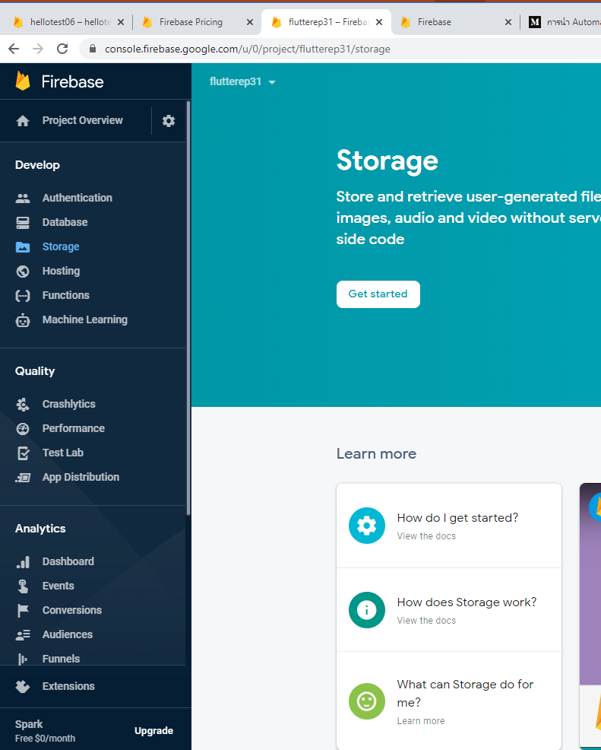
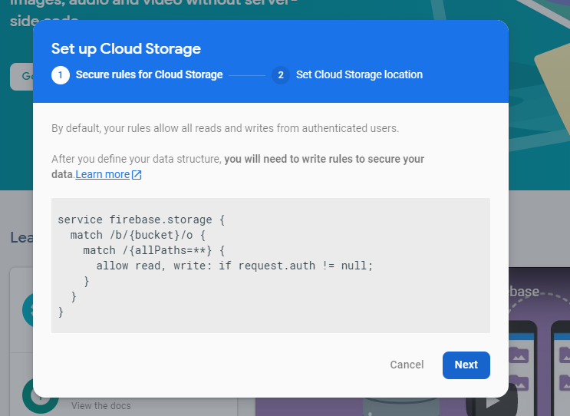
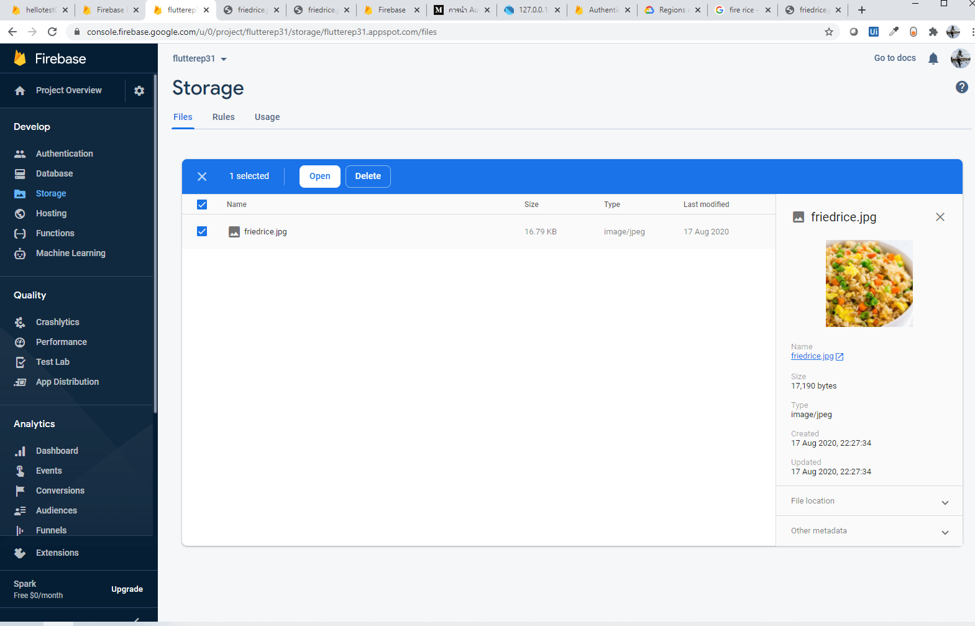
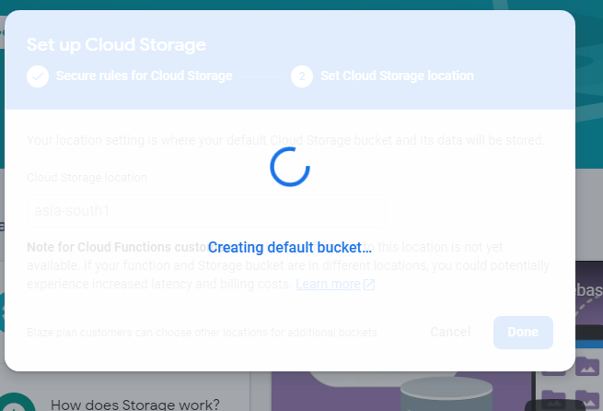
(1)-5 Start to use Firebase (Storage Cloud)

Slide 9
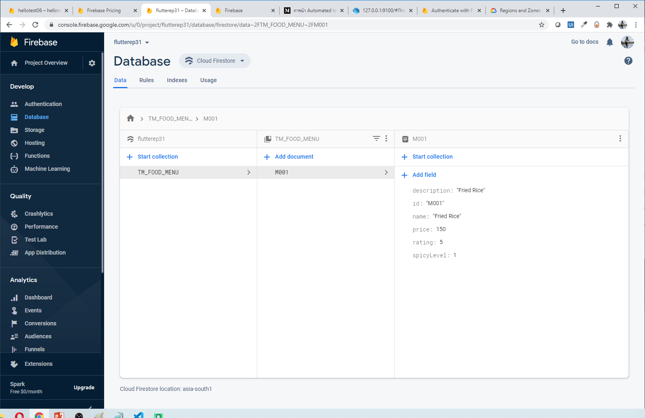
(1)-5-2 Start to use Firebase (Database)

Slide 10
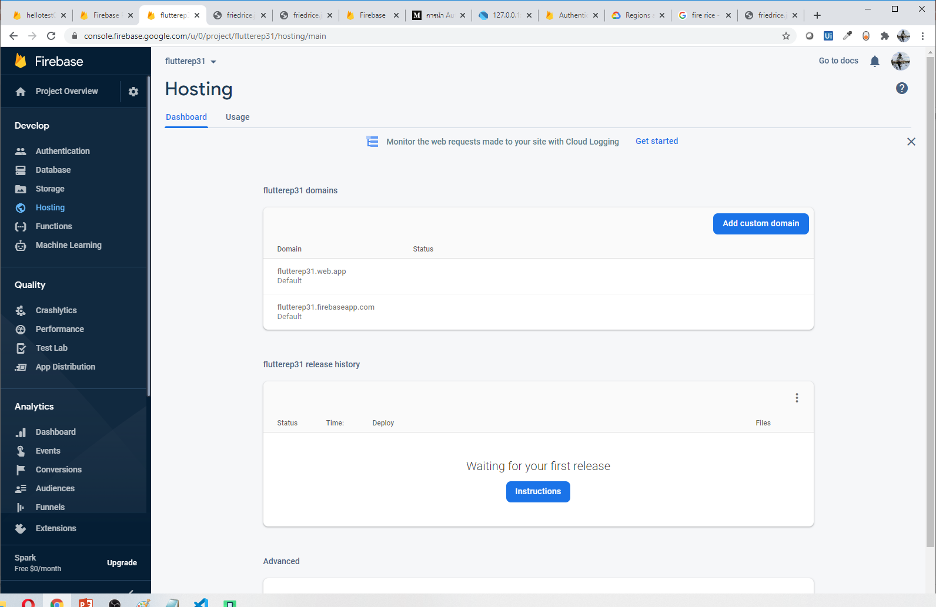
(1)-5-3 Start to use Firebase (Hosting/Website)
Free Web Server for Flutter

Slide 11
(2) Create Firebase Project
(2)-1 Create Project
Name: flutterep81
(2)-2 Add app
Andriod
iOS
(2)-3 Enable Features
Enable Authentication (Login e.g. E-mail, Gmail)
Enable FireStorage (Keep File e.g. food images)
Enable FireStore (Database)
Json: google-services.json

Slide 12
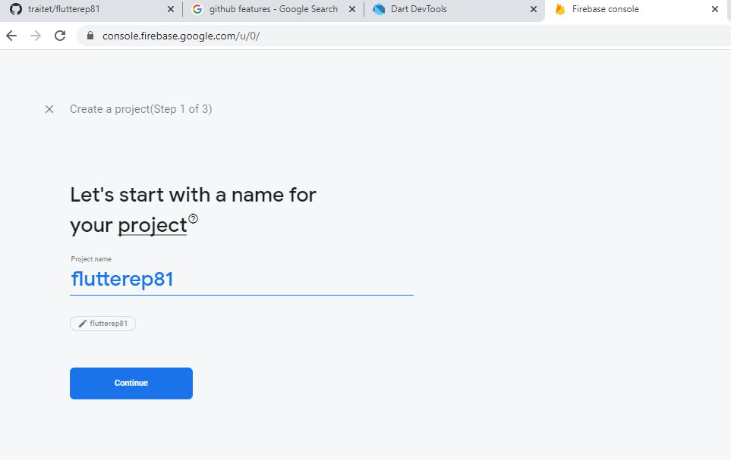
(2)-1 Create Project
Project Name: Flutterep81

Slide 13
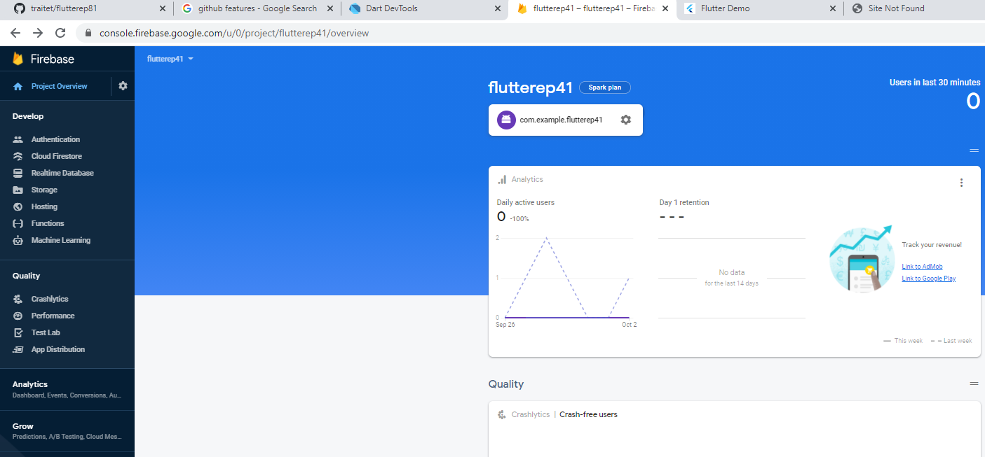
(2)-2 Add app (Andriod)

Slide 14
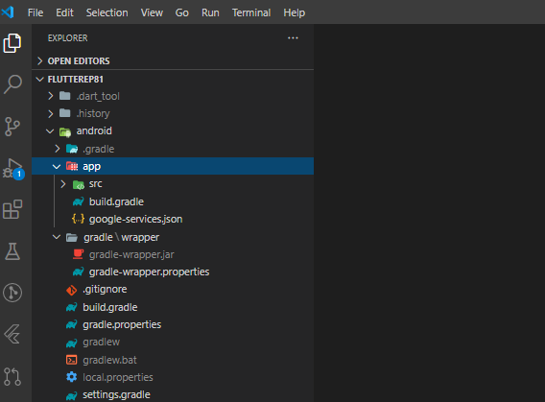
(2)-3 Config Flutter (Andriod)
Download google-services.json from Firebase web and copy to andriod/app path
Edit /andriod/app/build.gradle
Edit /andriod/build.gradle
Add packages in pubspec.yaml
firebase_authen
cloud_firestore
firebase_storage
2
1
3
4

Slide 15
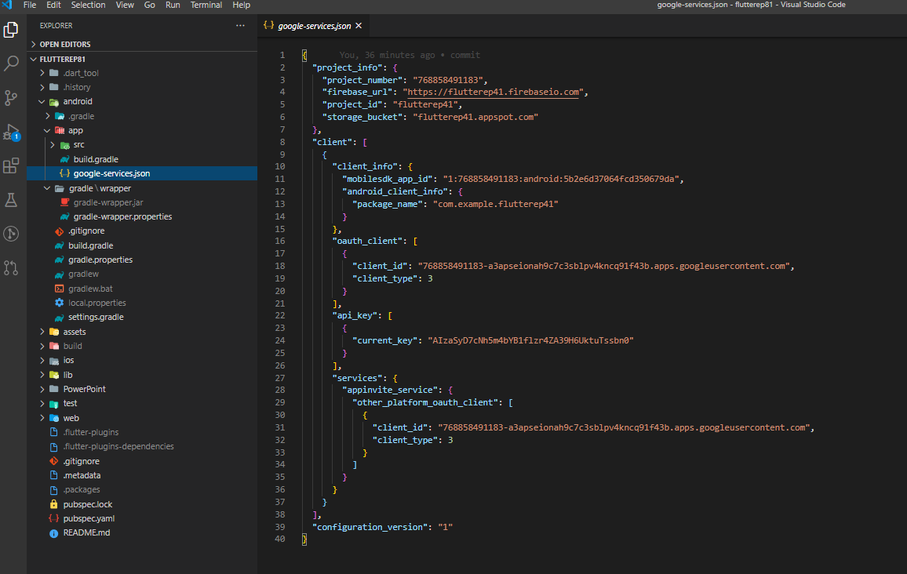
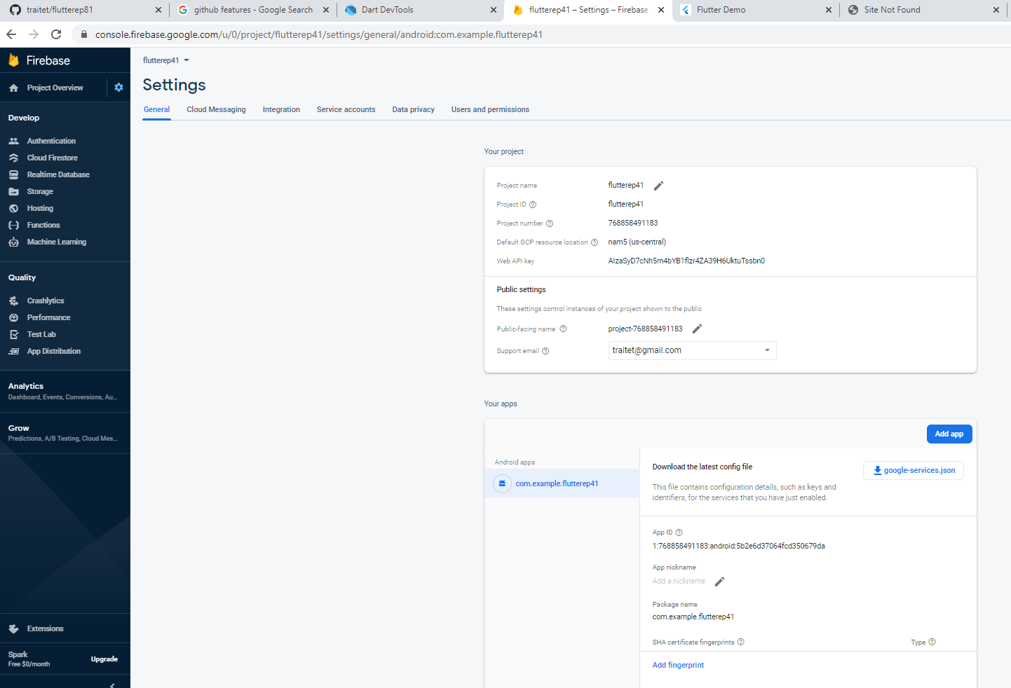
(2)-3-1 Edit /andriod/build.gradle

Slide 16
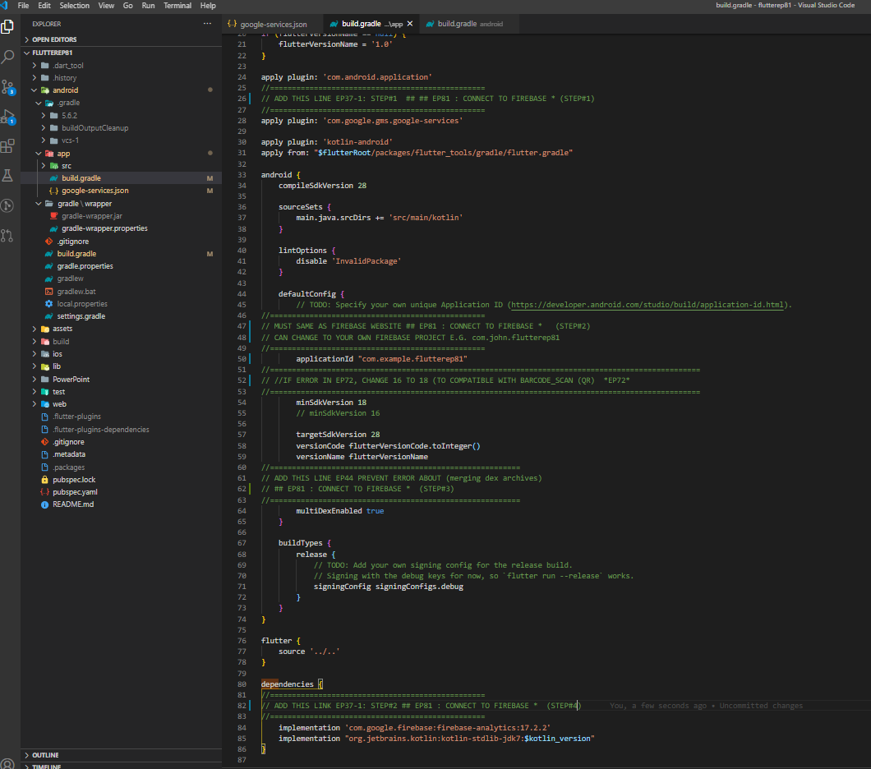
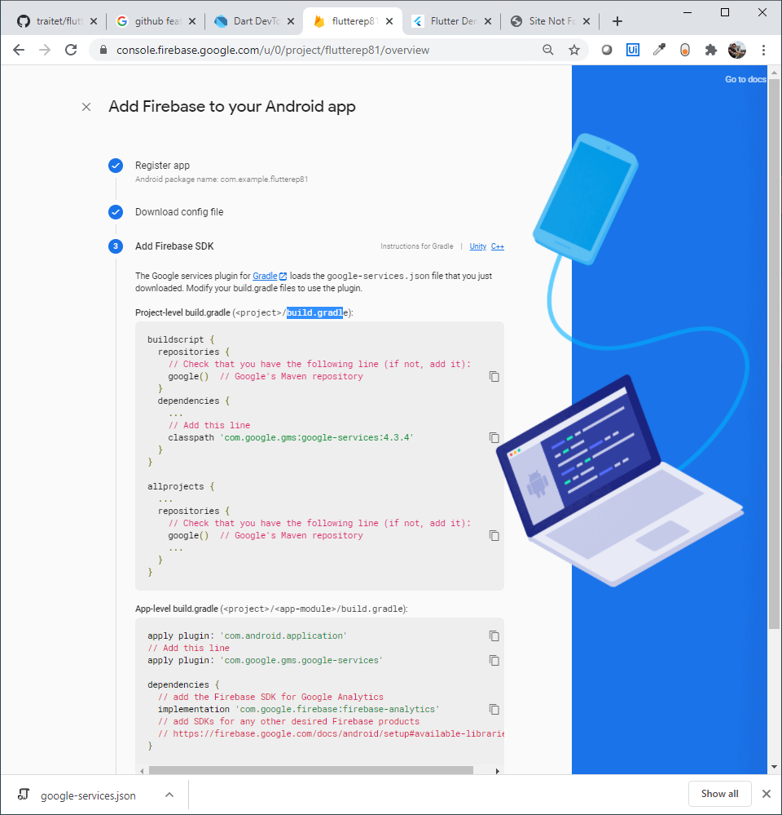
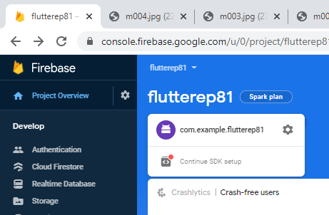
(2)-3-2 Edit /andriod/app/build.gradle
1
2
Must same as AppName in Firebase
3
4

Slide 17
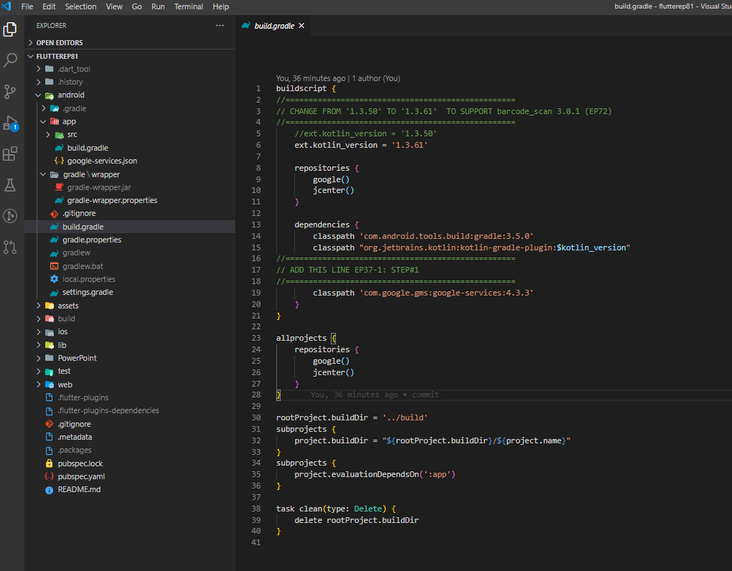
(2)-3-3 Edit /andriod/build.gradel

Slide 18
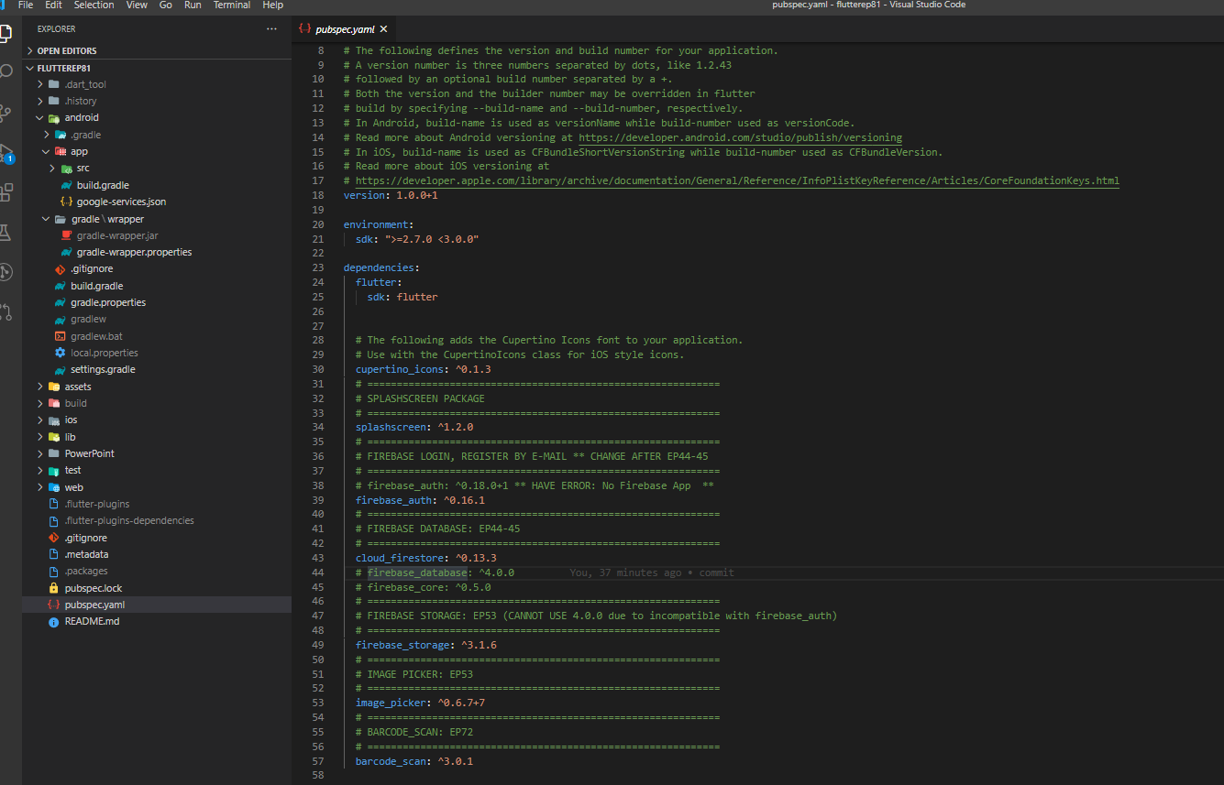
(2)-3-4 Add packages in pubspec.yaml
Add packages in pubspec.yaml
firebase_authen
cloud_firestore
firebase_storage

Slide 19
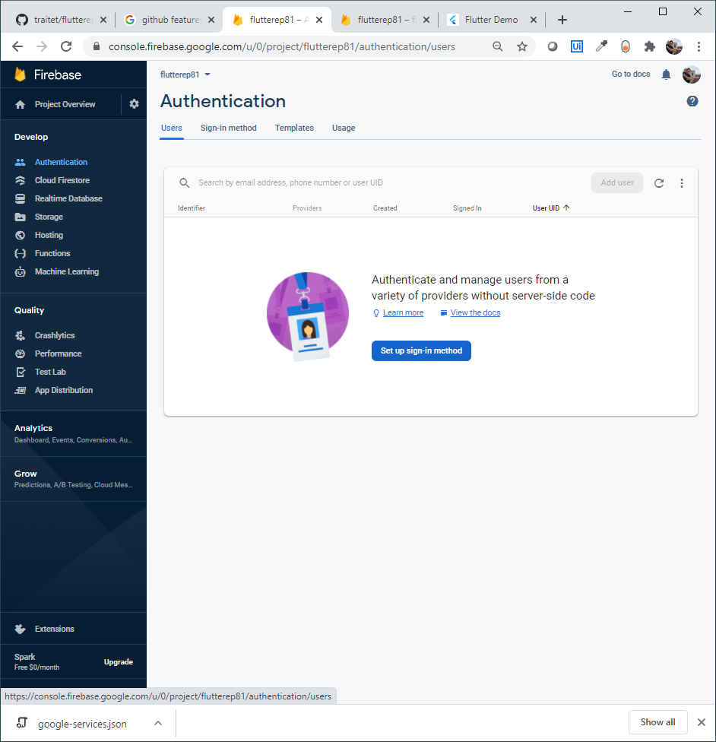
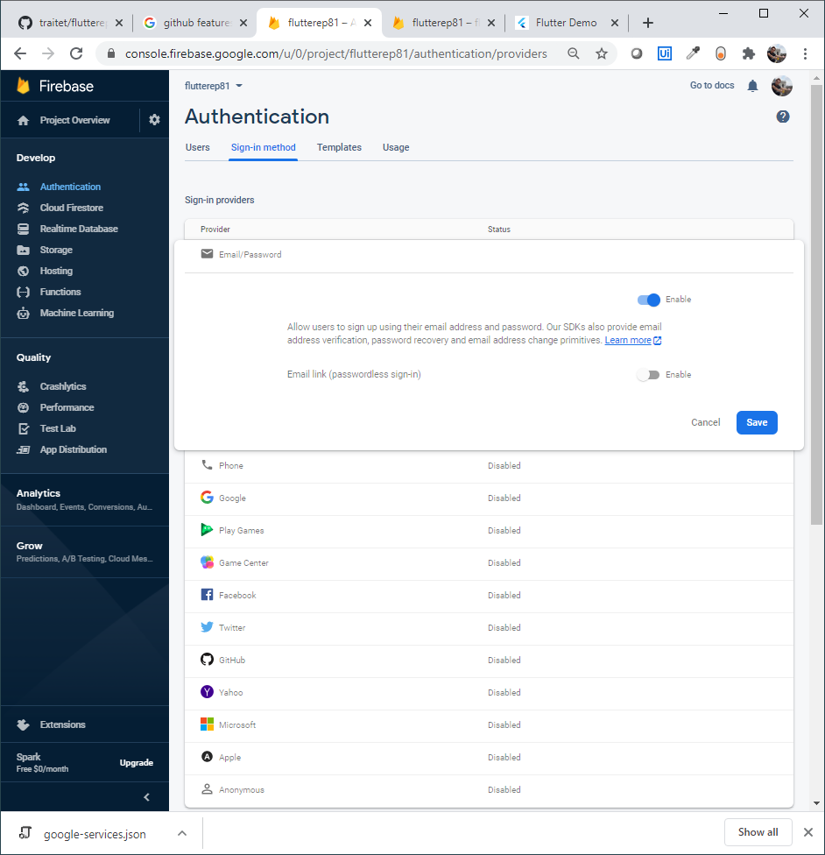
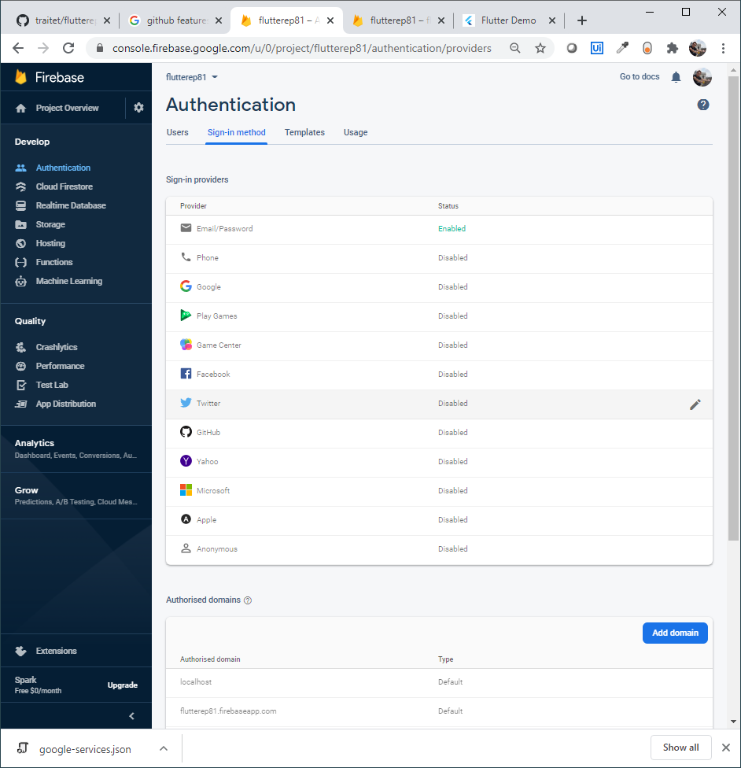
(2)-4-1: Enable authen services in Firebase

Slide 20
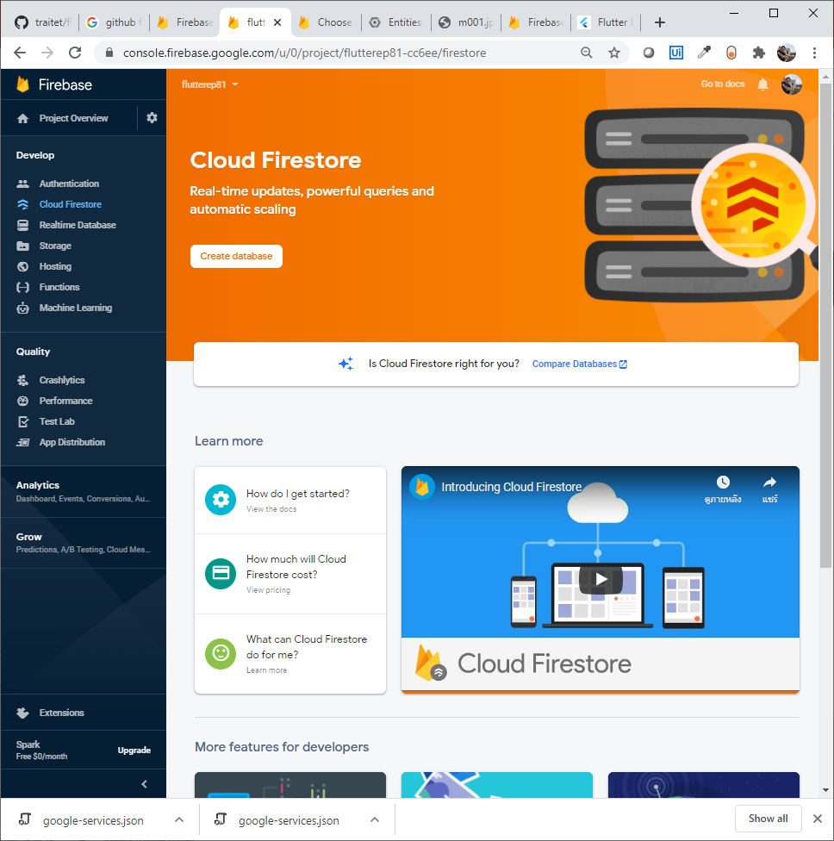
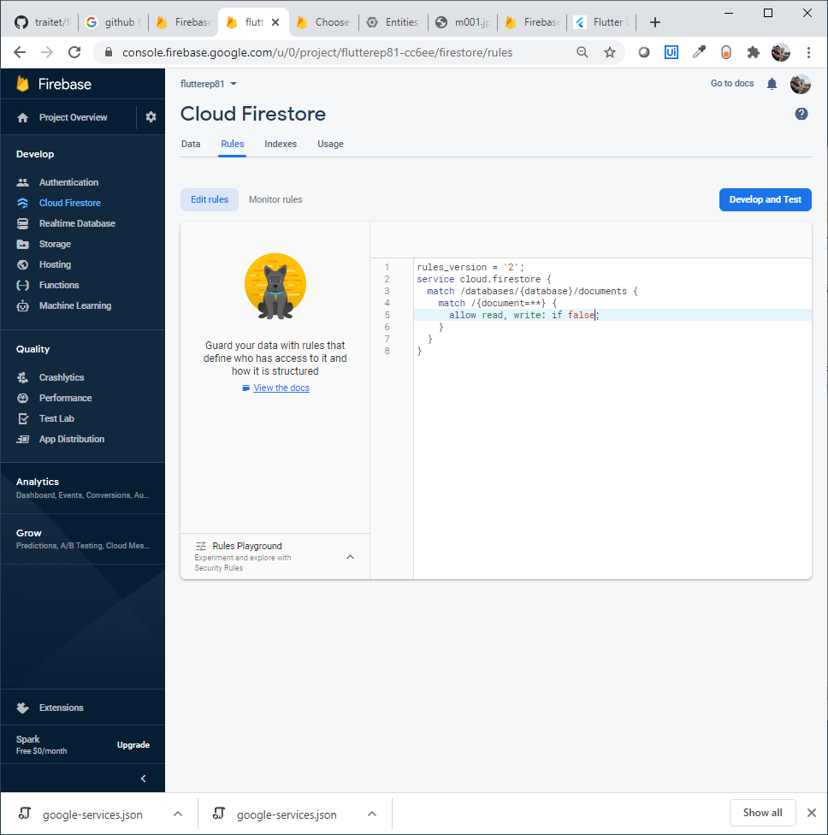
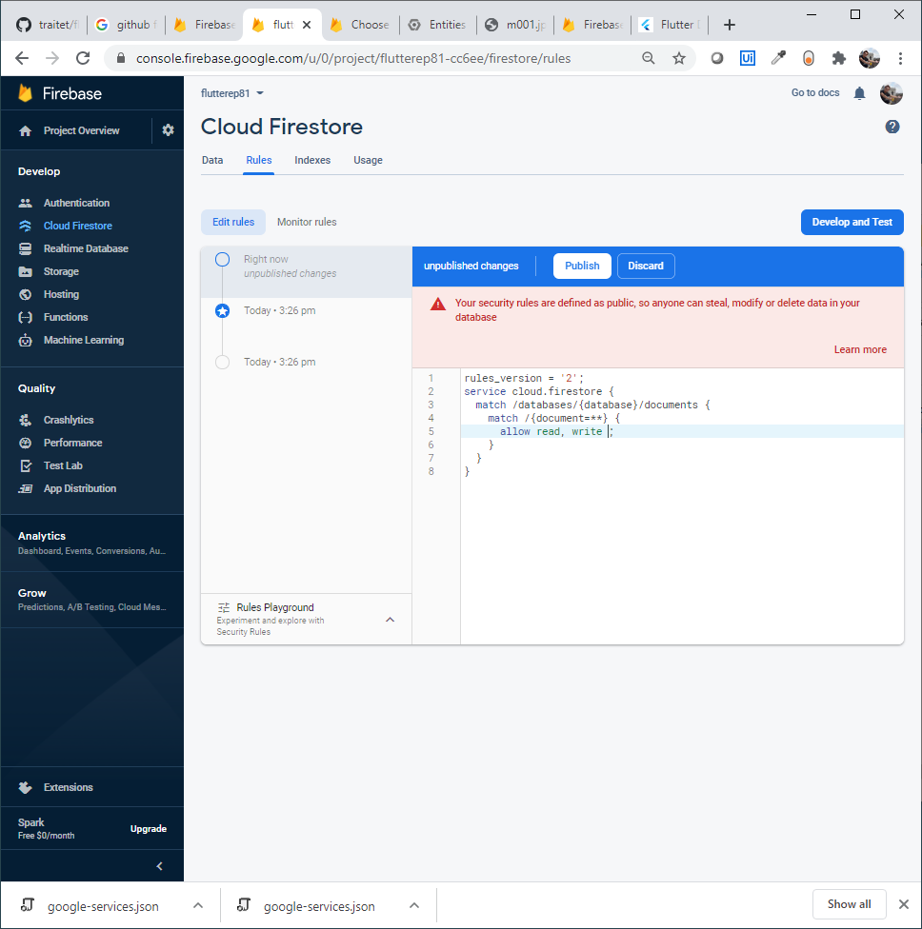
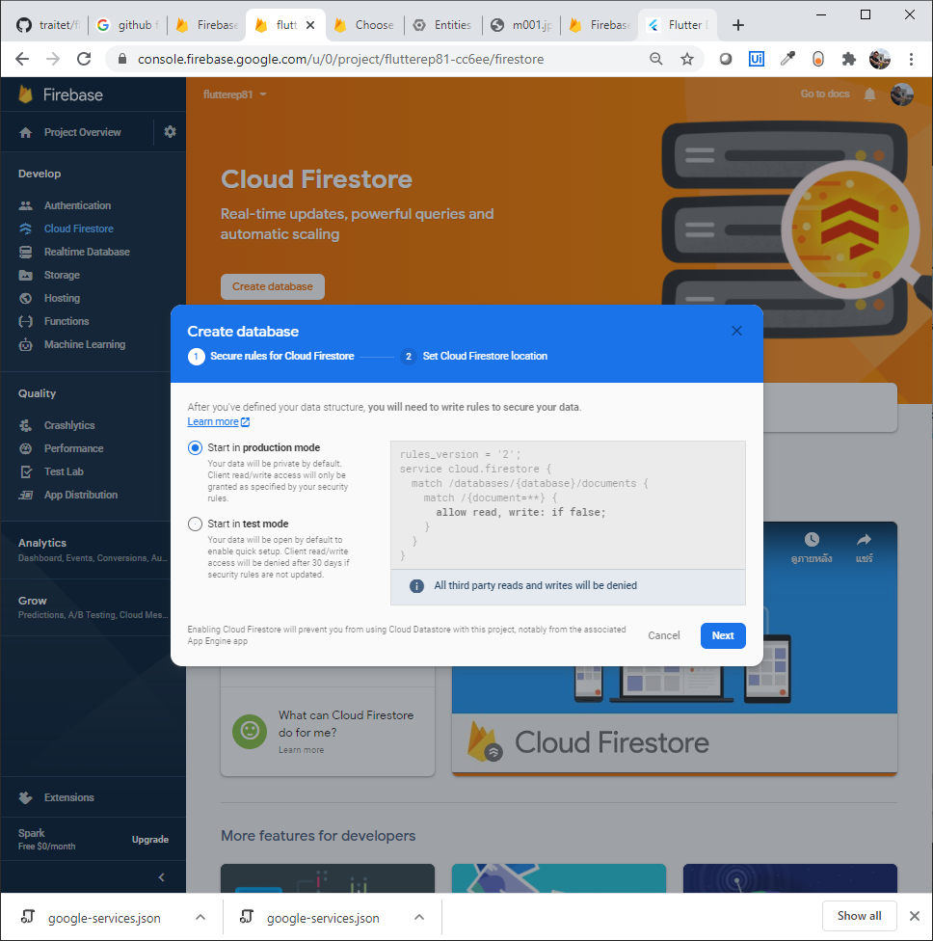
(2)-4-2: Enable FireStore Database
Remove
click “Publish”
Delete if false
Click “Publish”
Note: For anybody can access out DB without checking permission

Slide 21
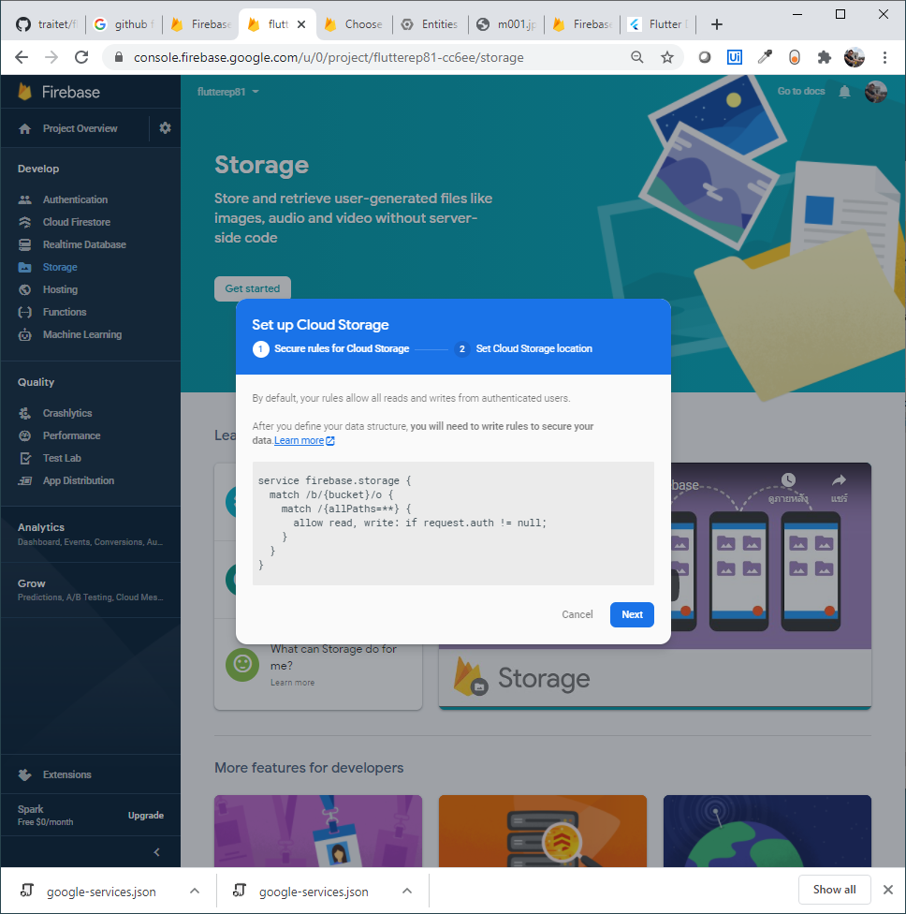
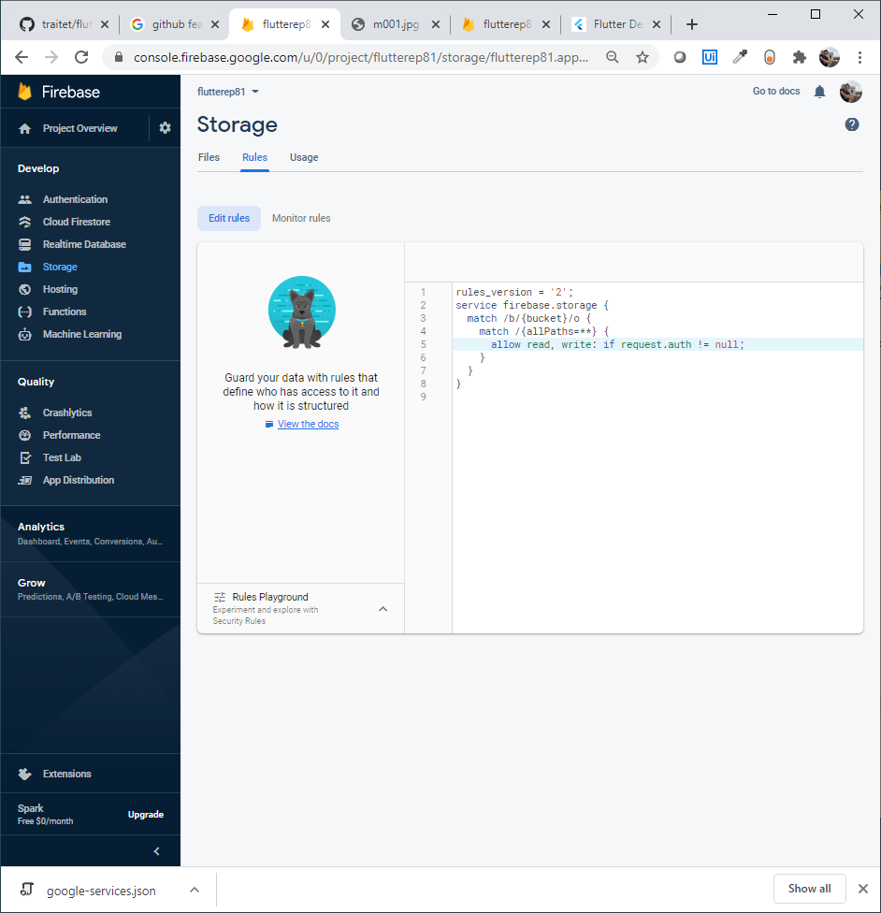
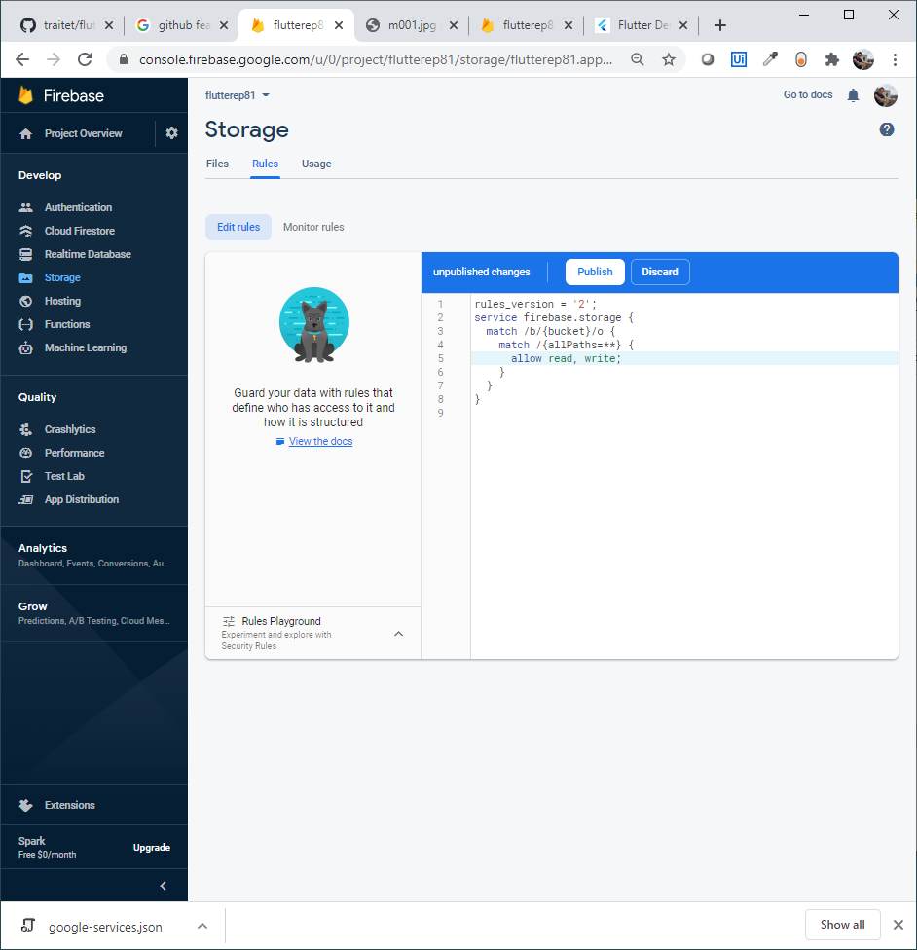
(2)-4-1: Enable Storage services in Firebase
Remove
click “Publish”
Delete if false
Click “Publish”
Note: For anybody can access out DB without checking permission

Slide 22
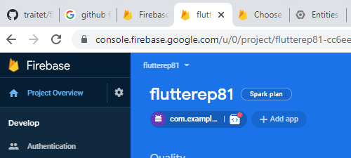
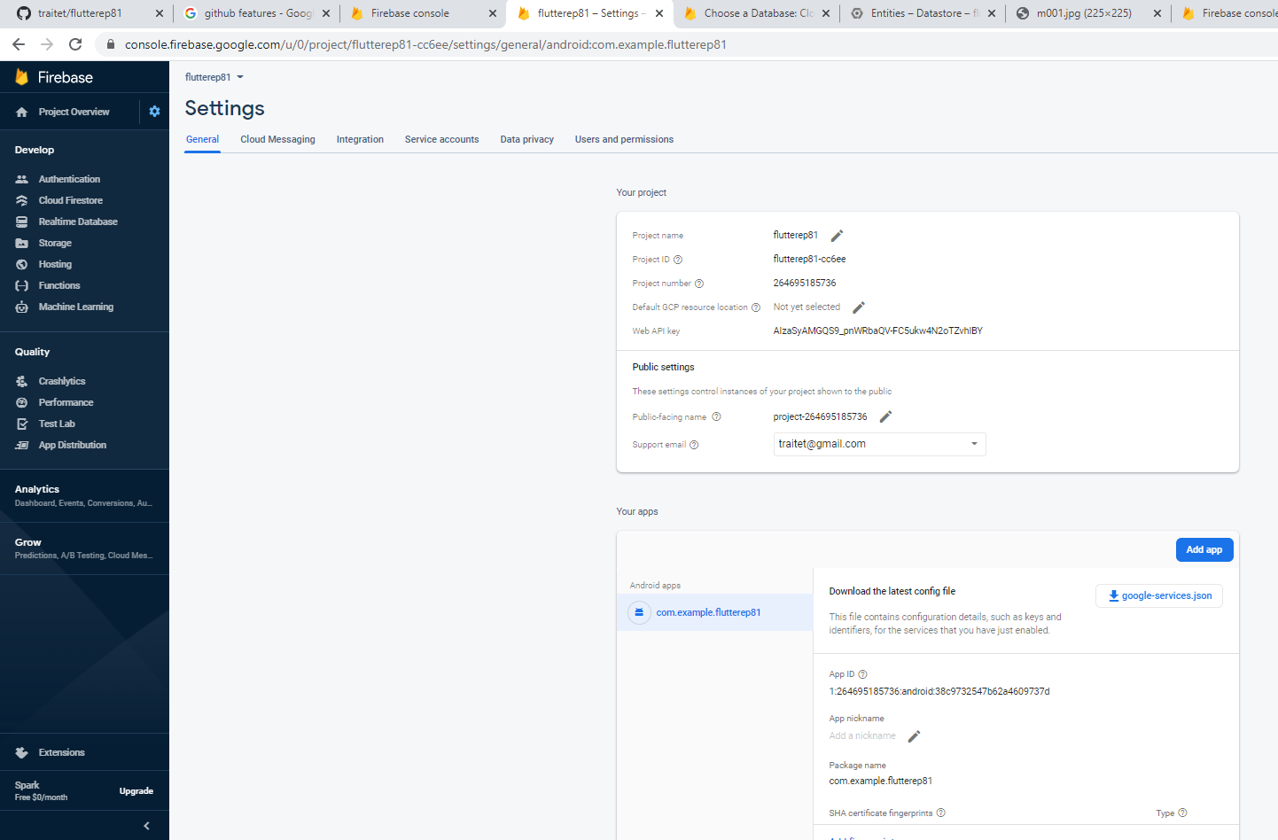
(2)-5 Additional Configure Project & download json file (Android)
File your email
Can download json file here

Slide 23
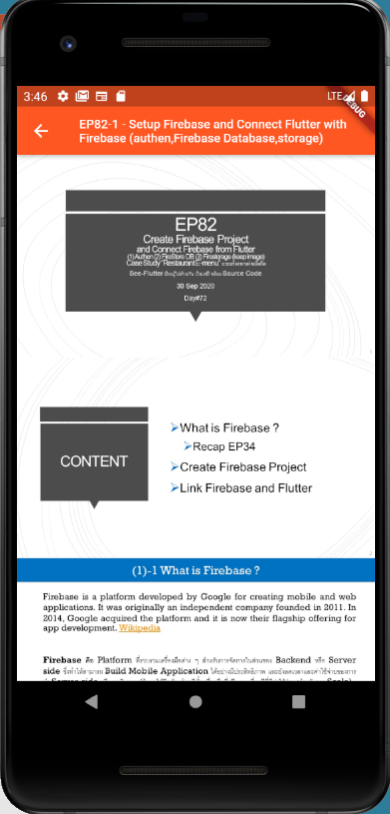
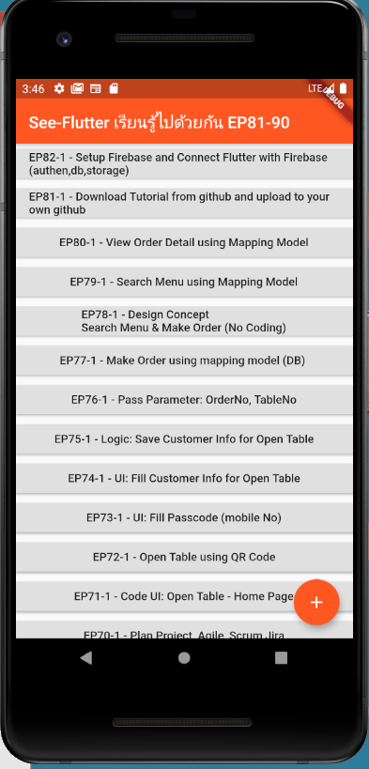
(3) Final UI

